Slide 1
Timers
Studio 5000
© 2021 John Sefcovic.

Slide 2
Timers Studio 5000
A Timer delays changing the state of an output.
A Timer can delay turning Off and output.
A Timer can delay turning On and output.
There are three Timer instructions.
Timer On Delay (TON)
Timer Off Delay (TOF)
Retentive Timer On (RTO)

Slide 3
Timers Studio 5000
The Timer Instructions are outputs.
The Timer begins elapsing time when the rung state changes.
The Timer uses a PRESET value to determine the duration of the delay.
The Timer uses an ACCUMULATED value to track the elapsed time.
The Timer uses a STATUS BIT to indicate when the PRESET value equals the ACCUMULATED value, the timer times out.
The Timer STATUS BIT state is used to control an output in the process or application.

Slide 4
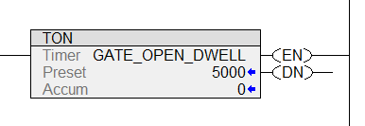
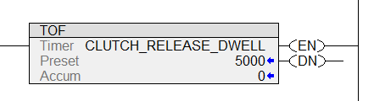
Timers Studio 5000
The Timer On Delay (TON) and Timer Off Delay (TOF) instructions in Studio 5000.
Timer On Delay (TON)
Timer Off Delay (TOF)

Slide 5
Timers Studio 5000
Tags are defined as TIMER Data Type.

Slide 6
Timers Studio 5000
The Preset is specified in milliseconds, 0.001.

Slide 7
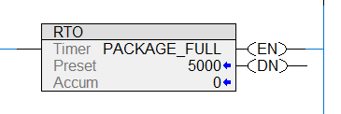

Timers Studio 5000
The Retentive Timer On (RTO) and Reset (RES) instructions in Studio 5000.
The Preset is specified in milliseconds, 0.001.
Tags are defined as TIMER Data Type.

Slide 8
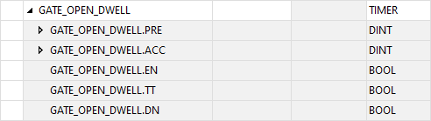
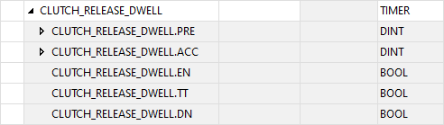
Timers Studio 5000
The Preset, Accumulated, and Status Bits are associated with the Tag.
Notice the Tags are a Timer Data Type.

Slide 9
Timers Studio 5000
The Preset, Accumulated, and Status Bits are associated with the Tag.
The Preset .PRE and Accumulated .ACC values are DINT (Double Integer number) Data Type.

Slide 10
Timers Studio 5000
TIMER PRESET and ACCUMULATED VALUES
The PRESET VALUE (.PRE) is the number of milliseconds the timer will elapse. How many millisecond the timer is set to run.
The ACCUMULATED VALUE (.ACC) is the current number of milliseconds the timer has elapsed. The number of millisecond the timer has ran.

Slide 11
Timers Studio 5000
The Preset, Accumulated, and Status Bits are associated with the Tag.
The Status Bits are BOOL (Bit) Data Type.

Slide 12
Timers Studio 5000
TIMER STATUS BITS
The ENABLE BIT (.EN) is an output that will turn on when the rung is True.
An Enable Bit may be used in a timer’s rung Holding Circuit or to control other outputs while the timer’s rung is True.
The TIMER TIMING BIT(.TT) is an output that will turn on when the Timer’s Accumulated value is Elapsing. Once the Preset and Accumulated Values are equal, the Timer Timing Bit output turns off.
The Timer Timing Bit may be used to turn On or Off other outputs (depending on the Input Instruction addressed to the TT bit) while the timer is elapsing.
The DONE BIT (.DN) is an output that changes when the Preset and Accumulated Values are equal. The Done Bit is used to control other outputs once the timing cycle is complete.
The change of the Done Bit from off to on or on to off depends on the Timer instruction type.

Slide 13



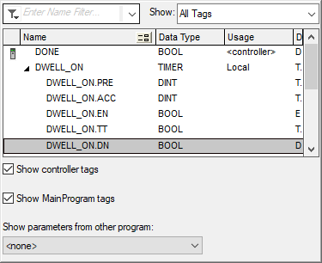
Timers Studio 5000
TIMER STATUS BITS
The Status Bits DN, EN, and TT are addressed with the Timer’s Tag.
In these example, the Timer Tag is DWELL_ON.
To address the Status Bit, the Timer Tag is expanded, and then the tag’s Status Bit is selected.

Slide 14
Timers Studio 5000
TIMER ON DELAY (TON)
The Timer On Delay (TON) is an output instruction that will turn on a controlled output when the accumulated value is equal to the preset value.
The equal values will result in the Done bit being set. The Done bit may be used to control other logic.
While the rung is true, the timer will begin to elapse at time base intervals at 0.001 of a second.

Slide 15
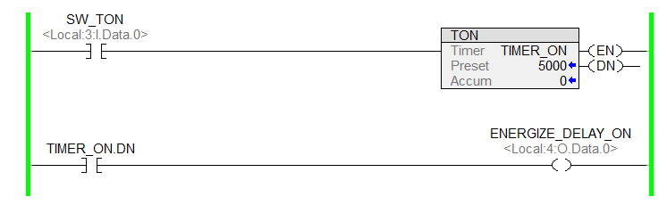

Timers Studio 5000
When the rung is FALSE, the Accumulated value for the timer does not increment.
ACCUMULATED VALUE
TIMER TIMING BIT
ENABLE BIT
DONE BIT
ZERO
RESET
RESET
RESET

Slide 16
Timers Studio 5000
Notice the Timer’s Done (.DN) bit is reset, making the input instruction False.
When the rung is FALSE, the Accumulated value for the timer does not increment.
ACCUMULATED VALUE
TIMER TIMING BIT
ENABLE BIT
DONE BIT
ZERO
RESET
RESET
RESET

Slide 17
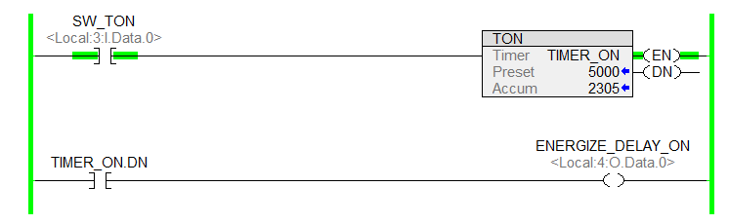
Timers Studio 5000
When the rung is TRUE, the Accumulated value for the timer does increment.
ACCUMULATED VALUE
TIMER TIMING BIT
ENABLE BIT
DONE BIT
INCREMENTS
SET
SET
RESET

Slide 18
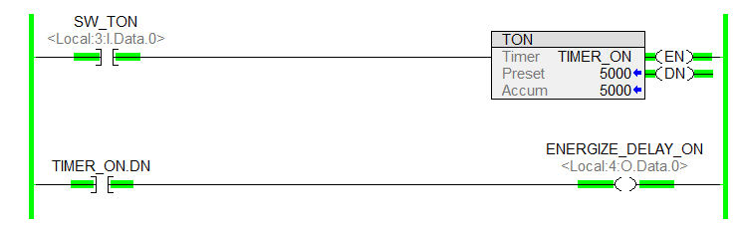
Timers Studio 5000
When the rung is TRUE, and the Accumulated value is EQUAL to the Preset value.
ACCUMULATED VALUE
TIMER TIMING BIT
ENABLE BIT
DONE BIT
STOPS
RESET
SET
SET

Slide 19
Timers Studio 5000
Notice the Timer’s Done (.DN) bit is set, making the input instruction True.
When the rung is TRUE, and the Accumulated value is EQUAL to the Preset value.
ACCUMULATED VALUE
TIMER TIMING BIT
ENABLE BIT
DONE BIT
STOPS
RESET
SET
SET

Slide 20
Timers Studio 5000
The controlled output is delayed turning On.
When the rung is TRUE, and the Accumulated value is EQUAL to the Preset value.
ACCUMULATED VALUE
TIMER TIMING BIT
ENABLE BIT
DONE BIT
STOPS
RESET
SET
SET

Slide 21
Timers Studio 5000
When the rung returns to FALSE, the Accumulated and Status Bits return to the initial settings.
ACCUMULATED VALUE
TIMER TIMING BIT
ENABLE BIT
DONE BIT
ZERO
RESET
RESET
RESET

Slide 22
Timers Studio 5000
When the Timer’s rung goes False, even when elapsing, the Timer return to the initial settings
When the rung returns to FALSE, the Accumulated and Status Bits return to the initial settings.
ACCUMULATED VALUE
TIMER TIMING BIT
ENABLE BIT
DONE BIT
ZERO
RESET
RESET
RESET

Slide 23
Timers Studio 5000
TIMER OFF DELAY (TOF)
The Timer Off Delay (TOF) is an output instruction that will turn off a controlled output when the accumulated value is equal to the preset value.
The equal values will result in the Done bit being reset. The Done bit may be used to control other logic.
While the rung is false, the timer will begin to elapse at time base intervals at 0.001 of a second.

Slide 24
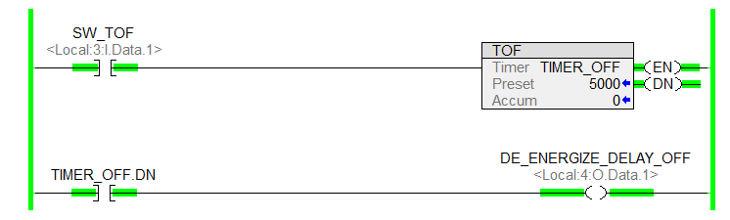
Timers Studio 5000
When the rung is TRUE, the Accumulated value for the timer does not increment.
ACCUMULATED VALUE
TIMER TIMING BIT
ENABLE BIT
DONE BIT
ZERO
RESET
SET
SET

Slide 25
Timers Studio 5000
Notice the Timer’s Done (.DN) bit is set, making the input instruction True.
When the rung is TRUE, the Accumulated value for the timer does not increment.
ACCUMULATED VALUE
TIMER TIMING BIT
ENABLE BIT
DONE BIT
ZERO
RESET
SET
SET

Slide 26
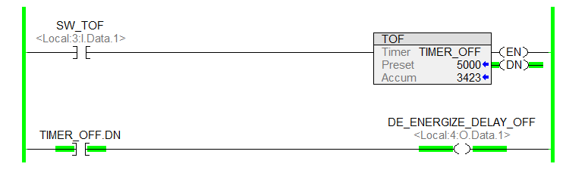
Timers Studio 5000
When the rung is FALSE, the Accumulated value for the timer does increment.
ACCUMULATED VALUE
TIMER TIMING BIT
ENABLE BIT
DONE BIT
INCREMENTS
SET
RESET
SET

Slide 27
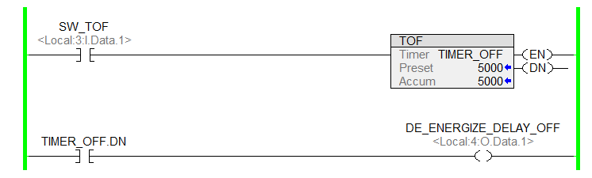
Timers Studio 5000
When the rung is FALSE, and the Accumulated value is EQUAL to the Preset value.
ACCUMULATED VALUE
TIMER TIMING BIT
ENABLE BIT
DONE BIT
STOPS
RESET
RESET
RESET

Slide 28
Timers Studio 5000
When the rung is FALSE, and the Accumulated value is EQUAL to the Preset value.
ACCUMULATED VALUE
TIMER TIMING BIT
ENABLE BIT
DONE BIT
STOPS
RESET
RESET
RESET

Slide 29
Timers Studio 5000
Notice the Timer’s Done (.DN) bit is reset, making the input instruction False.
When the rung is FALSE, and the Accumulated value is EQUAL to the Preset value.
ACCUMULATED VALUE
TIMER TIMING BIT
ENABLE BIT
DONE BIT
STOPS
RESET
RESET
RESET

Slide 30
Timers Studio 5000
The controlled output is delayed turning Off.
When the rung is FALSE, and the Accumulated value is EQUAL to the Preset value.
ACCUMULATED VALUE
TIMER TIMING BIT
ENABLE BIT
DONE BIT
STOPS
RESET
RESET
RESET

Slide 31
Timers Studio 5000
When the rung returns to TRUE, the Accumulated and Status Bits return to the initial settings.
ACCUMULATED VALUE
TIMER TIMING BIT
ENABLE BIT
DONE BIT
ZERO
RESET
SET
SET

Slide 32
Timers Studio 5000
When the Timer’s rung goes True, even when elapsing, the Timer return to the initial settings
When the rung returns to TRUE, the Accumulated and Status Bits return to the initial settings.
ACCUMULATED VALUE
TIMER TIMING BIT
ENABLE BIT
DONE BIT
ZERO
RESET
SET
SET

Slide 33
Timers Studio 5000
A simple question…
How can you delay turning something ON if it is already ON?
Therefore, for a Timer On Delay (TON) the initial condition for the rung is FALSE.
How can you delay turning something OFF if it is already OFF?
Therefore, for a Timer Off Delay (TOF) the initial condition for the rung is TRUE.

Slide 34
Timers Studio 5000
A simple question…
How can you delay turning something ON if it is already ON?
For a Timer On Delay (TON) the initial condition for the rung is FALSE and transitions to TRUE.
For a Timer Off Delay (TOF) the initial condition for the rung is TRUE and transitions to FALSE.
Therefore, for a Timer On Delay (TON) the initial condition for the rung is FALSE.
How can you delay turning something OFF if it is already OFF?
Therefore, for a Timer Off Delay (TOF) the initial condition for the rung is TRUE.

Slide 35
Timers Studio 5000
In most cases, the process has a rung condition transitions from FALSE to TRUE.
FALSE to TRUE
Then if the rung is TRUE, how can you delay turning something off.
Remember, a Timer Off Delay (TOF) delays when the rung conditions transitions from TRUE to FALSE.
Timer Off Delay (TOF)
TRUE to FALSE
The FALSE to TRUE rung condition is opposite of what is need to have the TOF elapse to delay turning Off an output.

Slide 36
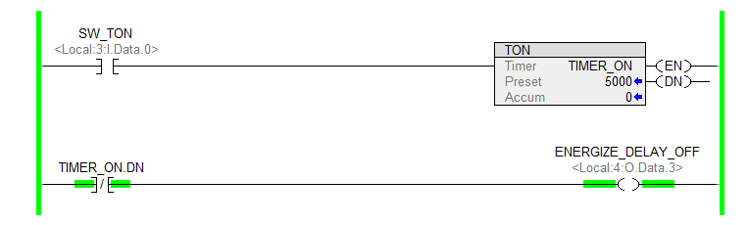
Timers Studio 5000
With a TON by using an XIO instruction addressed to the DONE status bit…

Slide 37
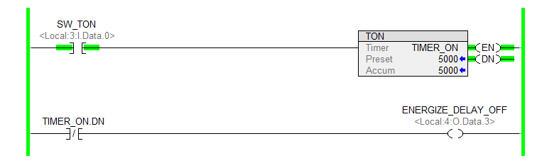
Timers Studio 5000
…the timer delays turning off the DONE status bit and the controlled output.

Slide 38
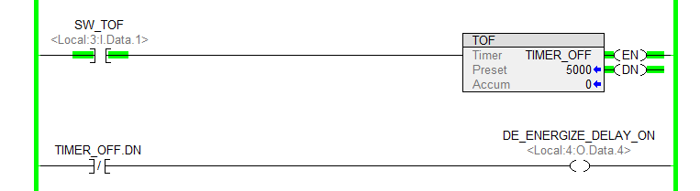
Timers Studio 5000
With a TOF by using an XIO instruction addressed to the DONE status bit…

Slide 39
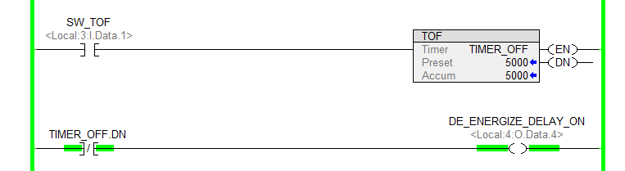
Timers Studio 5000
…the timer delays turning on the DONE status bit and the controlled output.

Slide 40
Timers Studio 5000
Summery of TON (Energize Timer) circuits.
Energized Timer Delay On
Energized Timer Delay Off

Slide 41
Timers Studio 5000
Summery of TOF (De-energize Timer) circuits.
De-energized Timer Delay Off
De-energized Timer Delay On

Slide 42
Timers Studio 5000
For a Timer On Delay (TON) the initial condition for the rung is FALSE and transitions to TRUE.
For a Timer Off Delay (TOF) the initial condition for the rung is TRUE and transitions to FALSE.
The final state of the rung determines if a TON or TOF timer is used.
If the rung state is TRUE, then to have the timer elapse a TON is used.
If the rung state is FALSE, then to have the timer elapse a TOF is used.

Slide 43
Timers Studio 5000
Retentive Timer On (RTO)
A Retentive Timer On (RTO) is similar to the Timer On Delay. The difference is the Retentive Timer will retain its accumulated value when the rung is false. When the rung is true, the accumulated value will increment from the current value.
When the accumulated and preset value are equal, the Done bit is set.

Slide 44
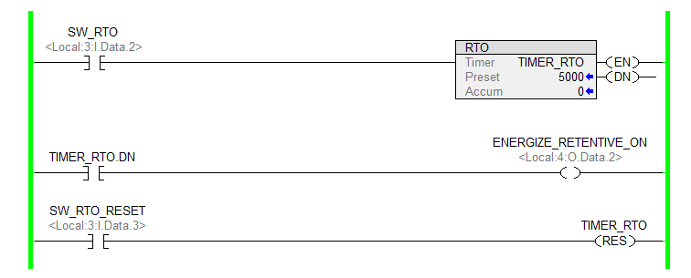
Timers Studio 5000
Similar to the Timer On Delay, the Retentive Timer On (RTO) when the rung is FALSE the Enable, Timer Timing, and Done status bits are reset.
The Accumulated value is at zero.

Slide 45
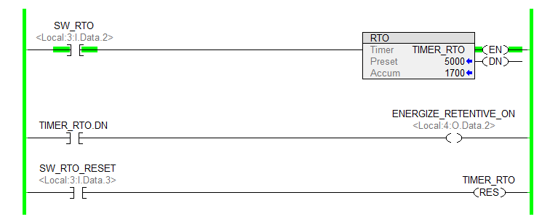
Timers Studio 5000
When the rung is TRUE the Enable and Timer Timing status bits are set. The Done is reset.
The Accumulated value is elapsing.

Slide 46
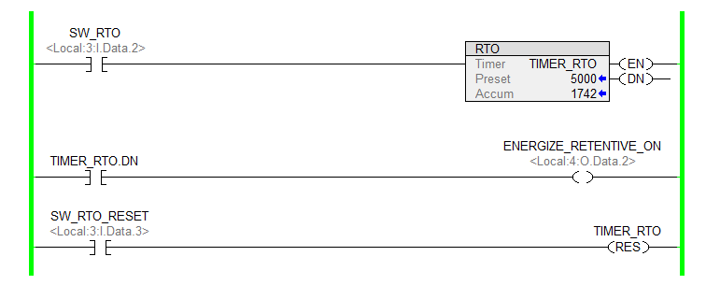
Timers Studio 5000
When the rung goes FALSE the Timer Timing status bits is set. The Enable and Done is reset.
The Accumulated value is retained.

Slide 47
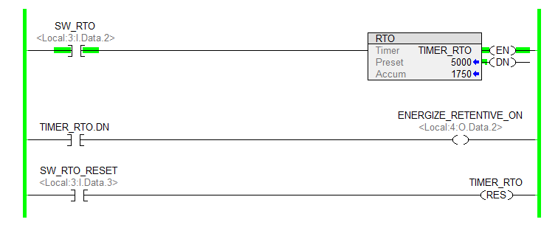
Timers Studio 5000
When the rung returns to TRUE the Enable and Timer Timing status bits are set. The Done is reset.
The Accumulated value continues to elapse.

Slide 48
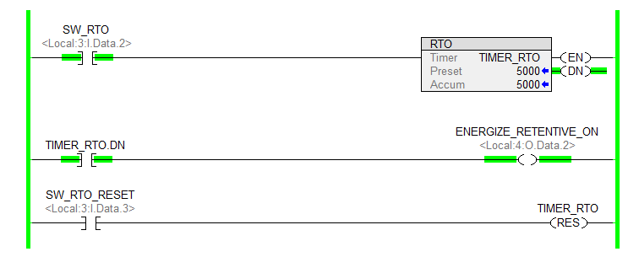
Timers Studio 5000
The Accumulated value is EQUAL to Preset value the accumulated value stops elapsing.
The Done is set and the Timer Timing is reset.
While the rung is TRUE the Enable is set.

Slide 49
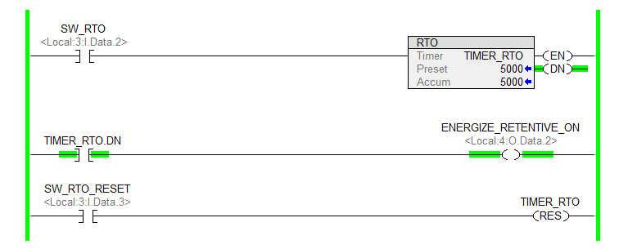
Timers Studio 5000
When the rung goes FALSE The Accumulated value remains equal to Preset.
The Done remains set.
The Enable is reset, and Timer Timing bit remains reset.

Slide 50
Timers Studio 5000
Reset (RES)
When the rung is TRUE, the Reset (RES) instruction returns the
Retentive Timer On (RTO) with the same address Accumulated value to zero

Slide 51
Timers Studio 5000
The Retentive Timer On (RTO) and the Reset (RES) instructions have the same Tag.

Slide 52
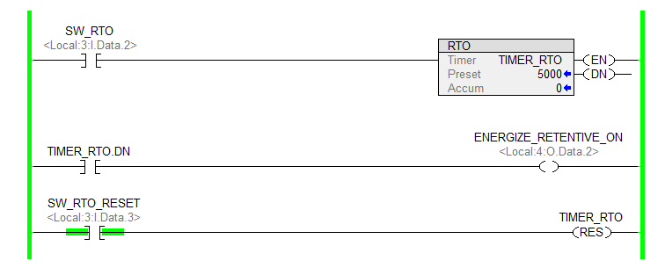
Timers Studio 5000
When the rung with the Tag Reset (RES) is TRUE, the Accumulated value returns zero.
The Done status bits is reset.

Slide 53
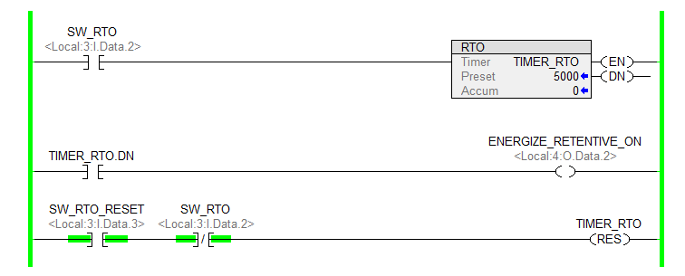
Timers Studio 5000
To prevent the from Timer elapsing and then resetting in the same scan, use an interlock to reset the timer when the timer is not commanded to run.

